Slide 1
Caring for the caregivers
Strategies for Supporting Parents and Carers of Children with Special Needs
An Amanati workshop www.amanati.org
Dr Amina Al-Yassin
GpwSI in Child and adolescent mental health
Barnardo’s national mental health team

Slide 2
What we will cover
The challenges of being a carer
The concept of a stress bucket
Strategies
Thought based strategies
Self care, looking after our own health and energy (spoon theory)
Amending expectations
Accessing parenting support
Getting support from family/friends
Support available through the council, education and health
Carers and support groups
Accessing mental health support for ourselves
Neurodiversity in the family

Slide 3
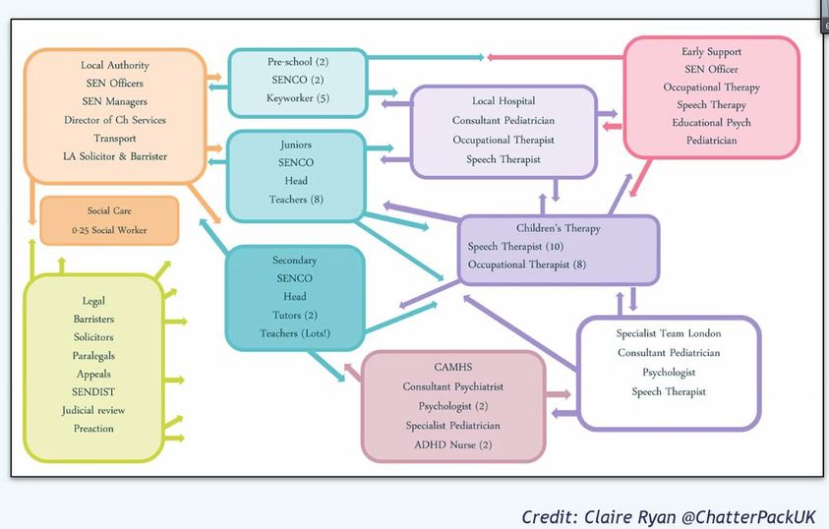
The challenges of being a carer
Increased Stress Levels
Anxiety and Depression
Social Isolation
Financial Strain
Impact on Marital Relationships
Notes:
Increased Stress Levels: Studies have shown that parents of children with disabilities experience higher levels of stress compared to parents of typically developing children (Journal of Developmental & Behavioral Pediatrics)
Anxiety and Depression: Research indicates that parents of children with disabilities are at a higher risk of experiencing anxiety and depression (Meta-analysis published in the Journal of Pediatric Psychology)
Social Isolation: A study published in the Journal of Autism and Developmental Disorders found that mothers of children with autism spectrum disorder reported higher levels of social isolation compared to mothers of typically developing children.
Financial Strain: Caring for a child with disabilities can impose significant financial strain on families. According to a report by the Centers for Disease Control and Prevention (CDC), families of children with special healthcare needs incur higher medical expenses and often face financial difficulties related to caregiving responsibilities.
Impact on Marital Relationships: Research published in the Journal of Family Psychology suggests that parents of children with disabilities may experience higher rates of marital dissatisfaction and divorce compared to parents of typically developing children.

Slide 4
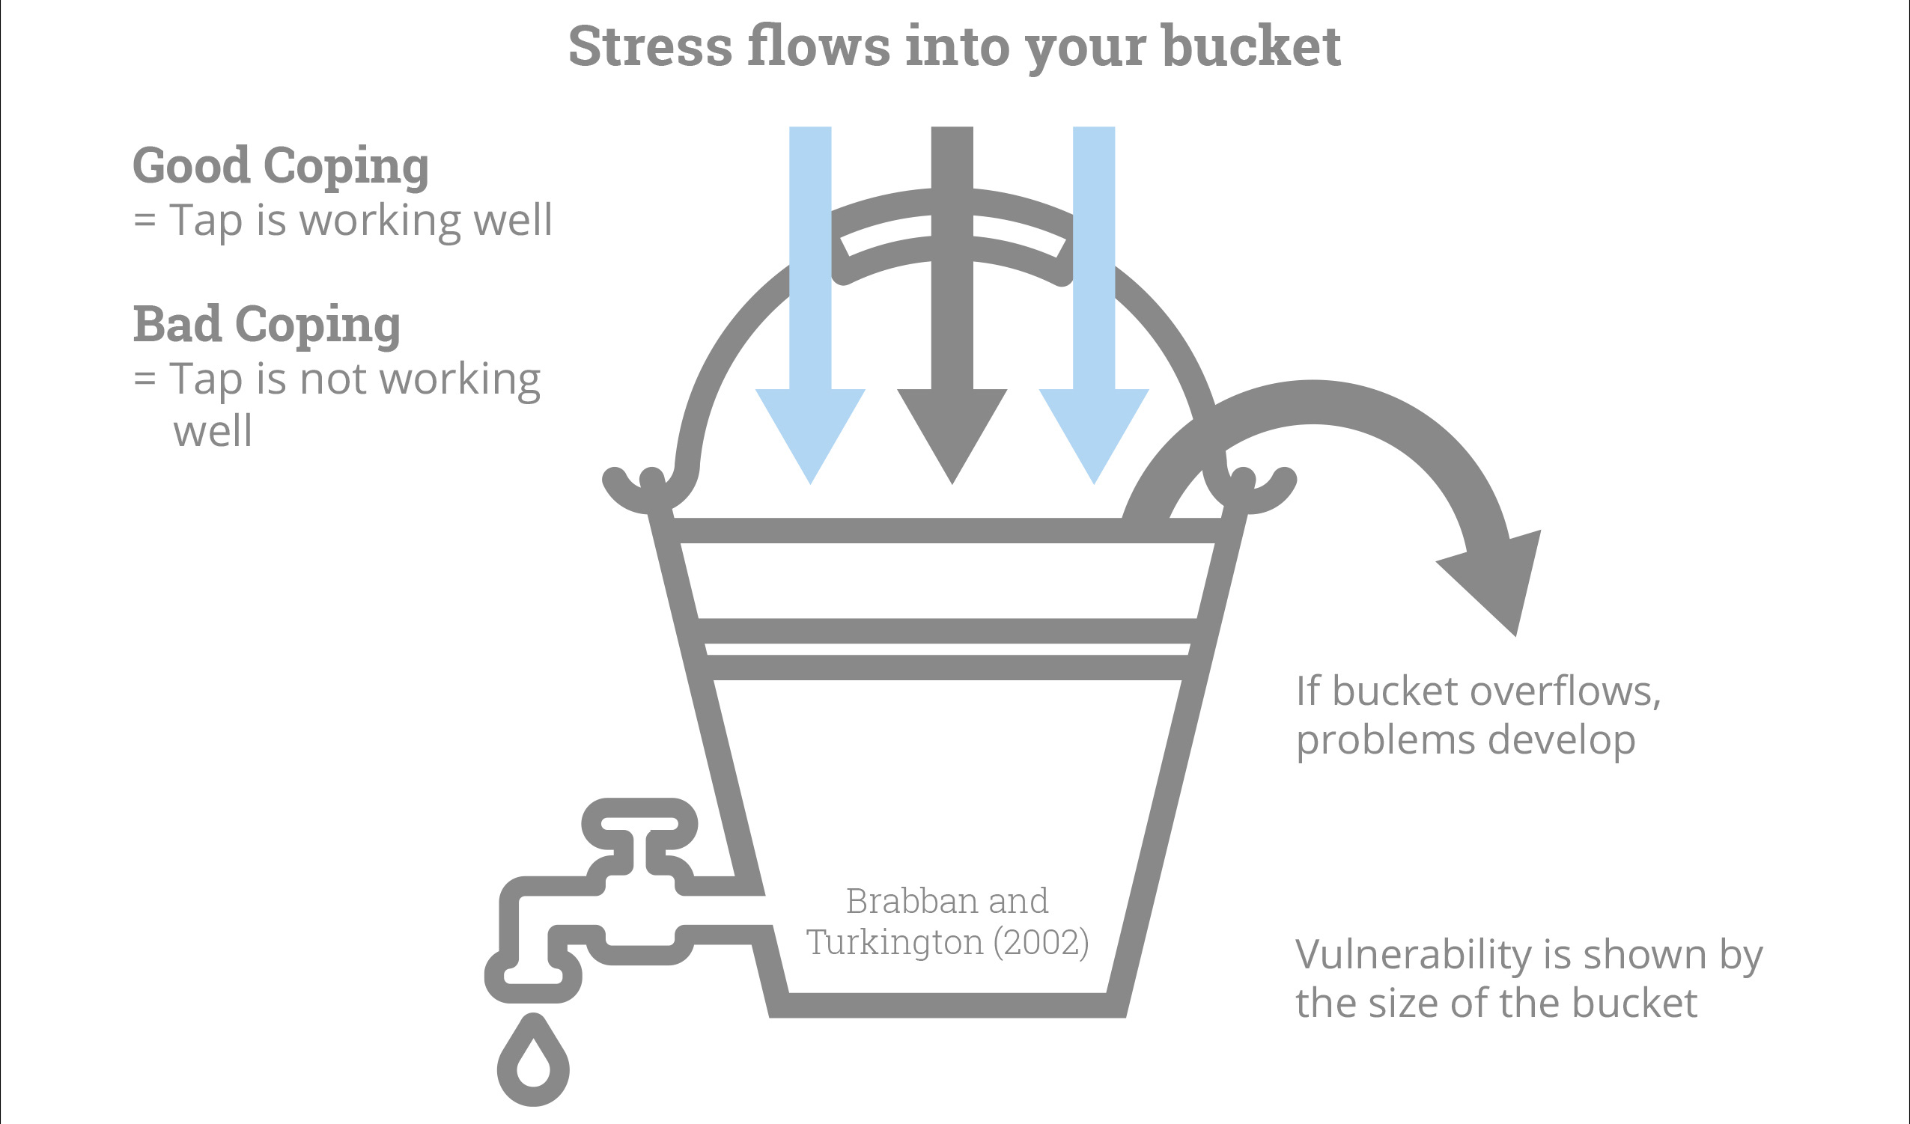
The stress bucket
Notes:
It is more likely that your buckets are bigger, and you have more stress flowing in. You are coping and doing well.

Slide 5
Strategies that can help: Thought based strategies
Are there any thoughts that help you when you are feeling overwhelmed?

Slide 6
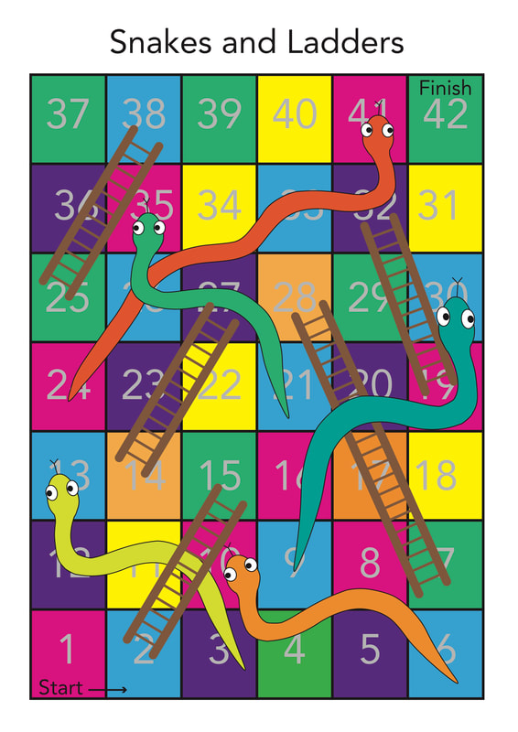
Strategies that can help: Thought based strategies
Allowing yourself time to feel and process your feelings (even the really difficult ones) can help you to gradually accept them
The new ABC: Acceptance belonging connection
Learning more about the condition your child may have, in some cases (e.g. neurodiversity) learning more about the new, non-deficit focused approaches
Our experts by experience (EBE) said “Radical acceptance, avoiding comparisons, grieving loss, learning to accommodate needs with resulting improvements in connection can improve things a lot. Surround yourself with people who ‘get it’. Hold onto the positives, however small”

Slide 7
Strategies that can help: Self-care
It is difficult to make time for self care, but when you have the least time is when you need it most
Self care does not need to be yoga or breathing exercises… find something that works for you
Think about things you can do in 30 seconds, 30 minutes and 3 hours… sometimes you will have more or less time
You can’t pour from an empty cup, or help anyone else if you are unwell so make time for your own health too

Slide 8
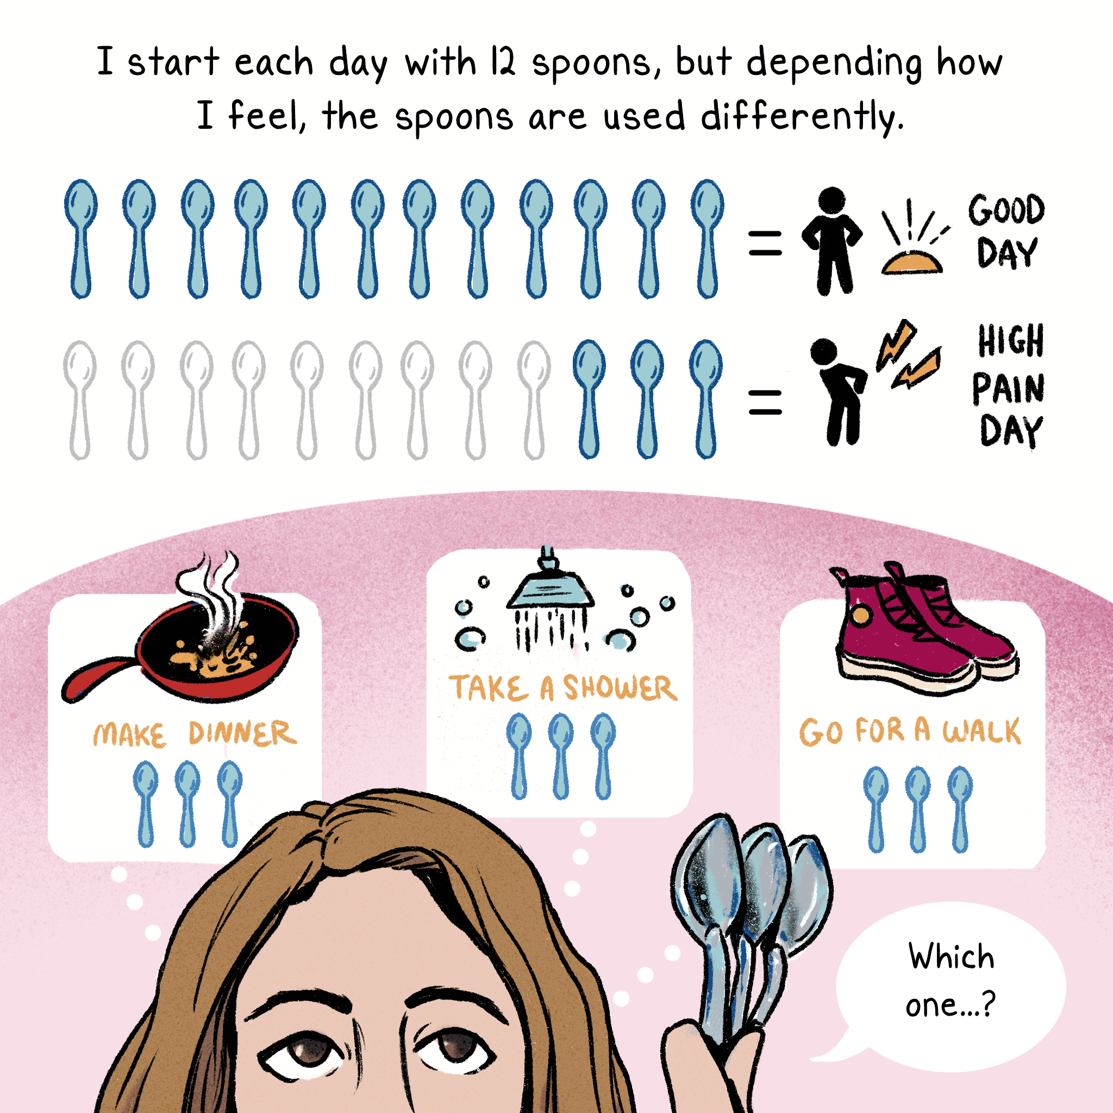
Spoon theory

Slide 9
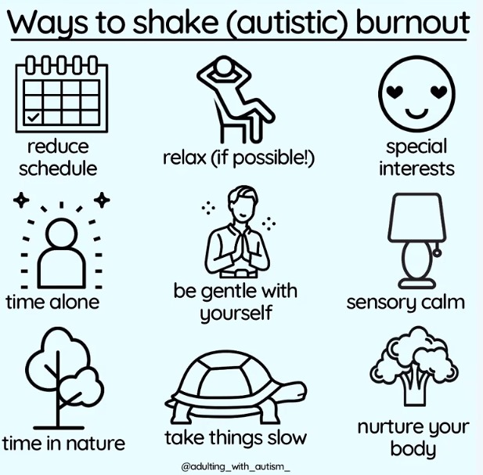
Strategies that can help: Self care
Learning more about self-care and practicing it can help us help our child too

Slide 10
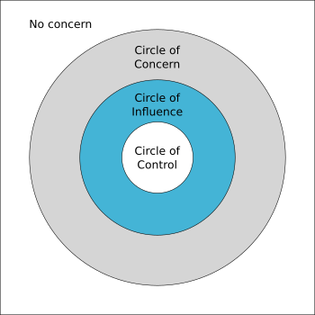
Strategies that can help: Amending expectations
Comparison is the thief of joy, and is quite often completely irrelevant
Controlling and manage what you can to reduce any additional stress. But there may be lots outside of your control too
Our EBE said they found that reducing expectations (e.g. about routines, frequency of showering/cooking, screentime etc) often helped to reduce stress and in turn everyone managed to find things easier and actually do more

Slide 11
Strategies that can help: Parenting support
Parenting support/courses may be useful, but not all mainstream parenting courses will be relevant or helpful
If violence/aggressive behaviour is a concern then Non-violent resistance parenting courses may be helpful. Some organisations e.g. YouthOptions may offer these for free
SCOPE offer free “Navigate” sessions for emotional support for parents of kids under assessment/within 1 year of diagnosis of a disability)
PDA can be very challenging & conventional parenting techniques often don’t work https://www.pdasociety.org.uk/
Accessing telephone based support e.g. the Youngminds helpline or Navigate/Scope

Slide 12
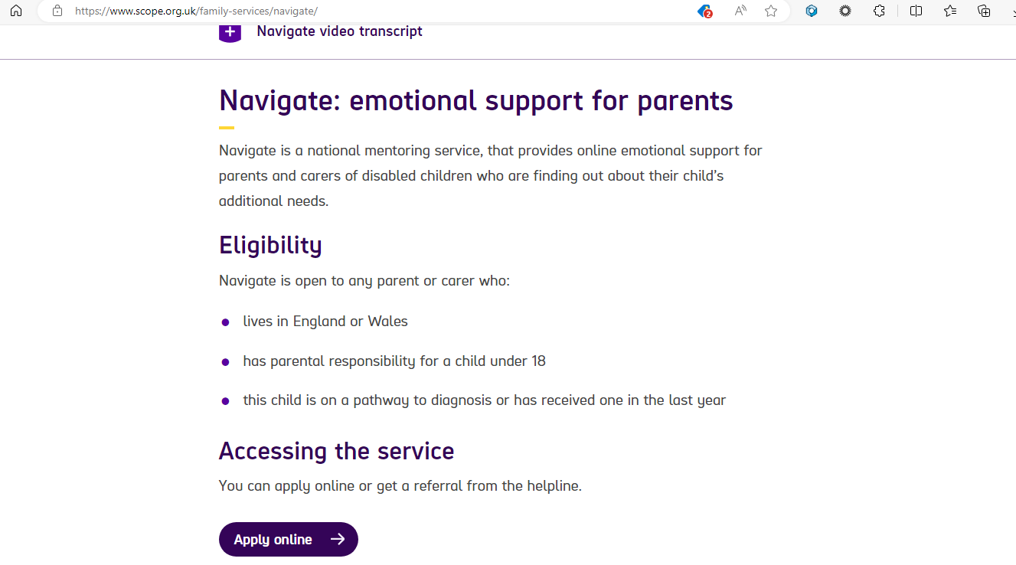

Slide 14
Strategies that can help: Council/social services based support
Ensure that you are getting all the benefits you are entitled to- Speak to Scope/ Citizens advice/ Social prescriber at your GP practice
Contact the health visitor/ local family wellbeing centres to ask about any services that are available e.g. playgroups
Check out the SEND local offer for your borough
Ask your social worker or education setting about respite care – this can include additional childcare over the holidays/weekends and for some eligible families residential care too

Slide 15
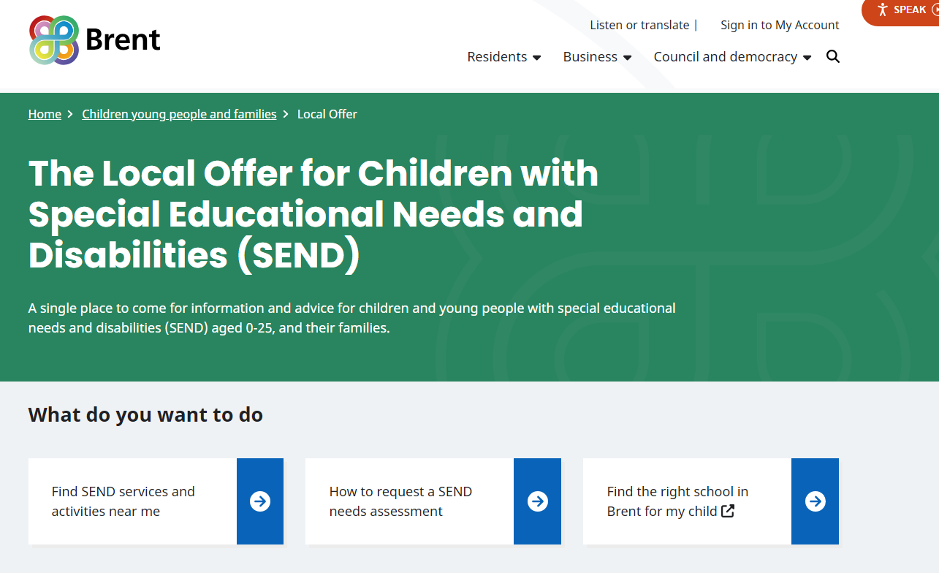

Slide 16
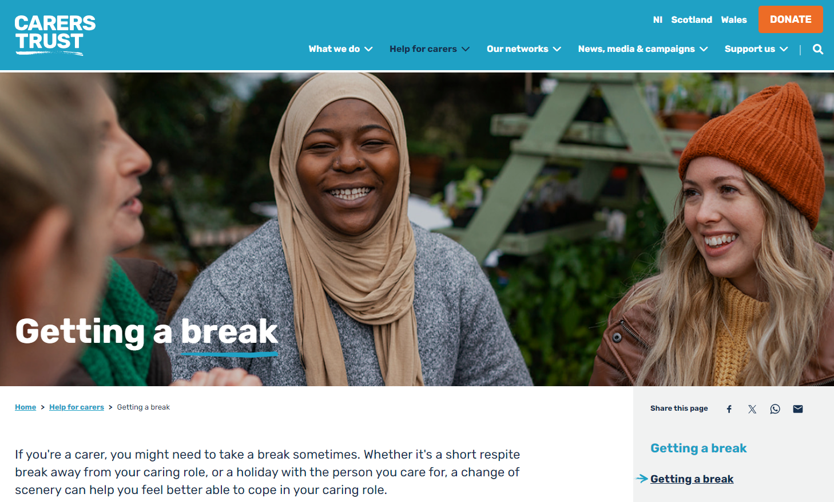

Slide 17
Strategies that can help: Carers and support groups
Formal support groups
Brent carers centre
Brent SENDIASS
Harrow Autism and ADHD centre
Online including condition specific groups especially for rare conditions
Staying in touch with Amanati
For those with rare conditions: UNIQUE
Informal support groups
Whatsapp groups
Facebook groups exist for many different

Slide 18
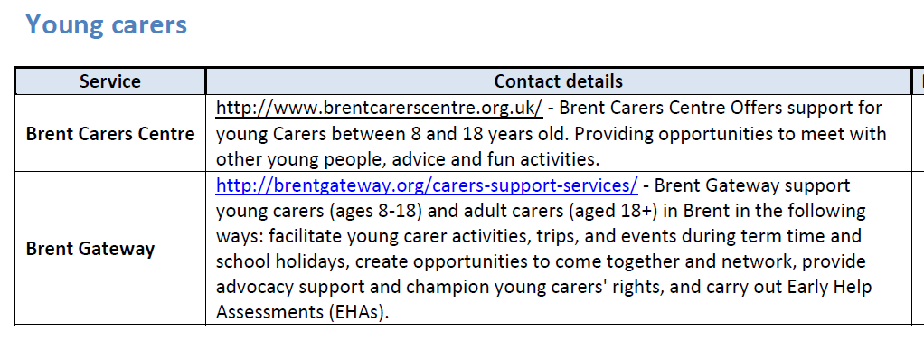

Slide 19
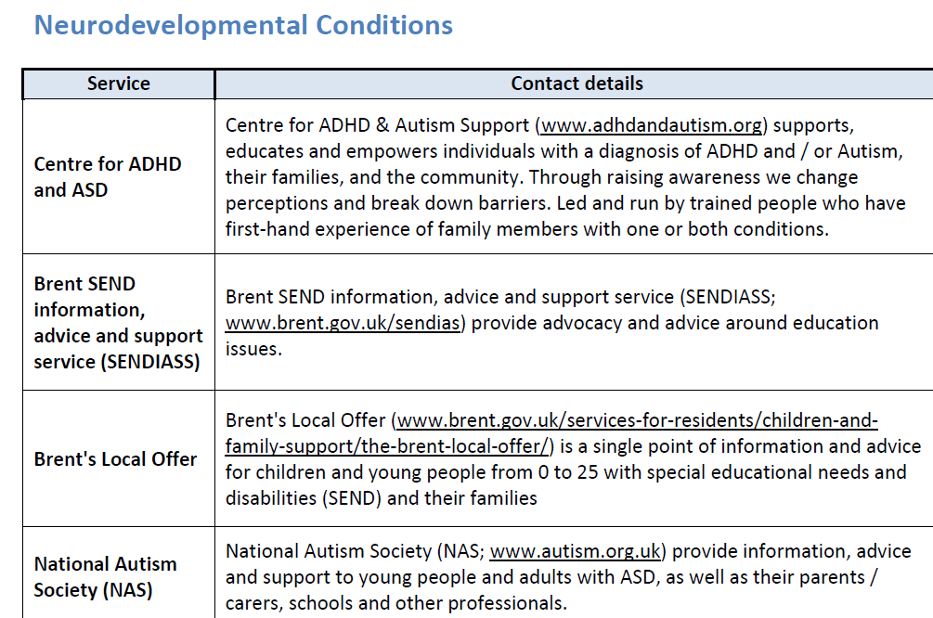

Slide 20
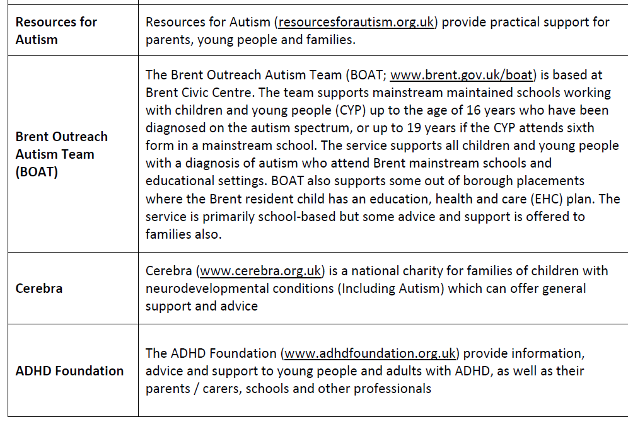

Slide 21
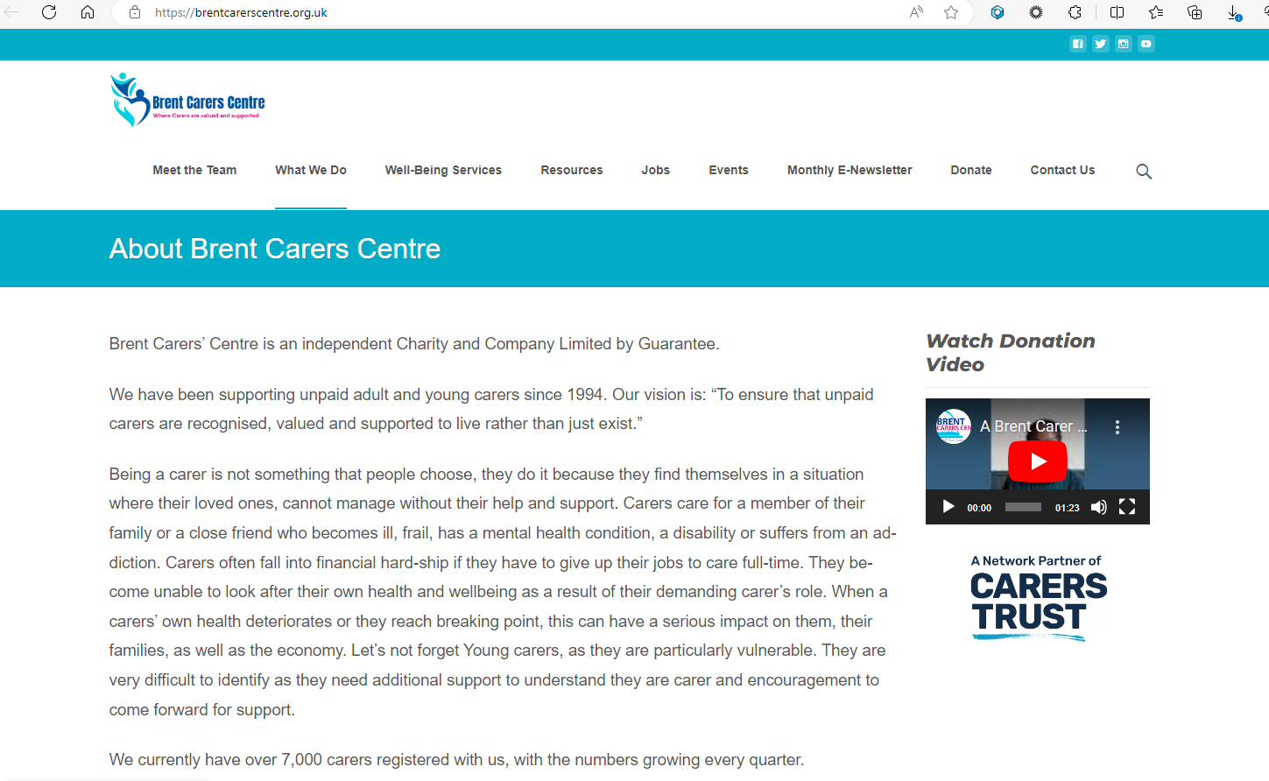

Slide 22
Strategies that can help: Mental health support
Accessing mental health support or counselling
There is absolutely no shame in getting support for your mental health- this is a very proactive thing to do, and the strategies and skills that you learn may be helpful for both you and your family
You can access mental health support by contacting your GP or NHS Talk directly: Find an NHS talking therapies services - NHS (www.nhs.uk)
Who else would benefit from this? Partner? Siblings?

Slide 23
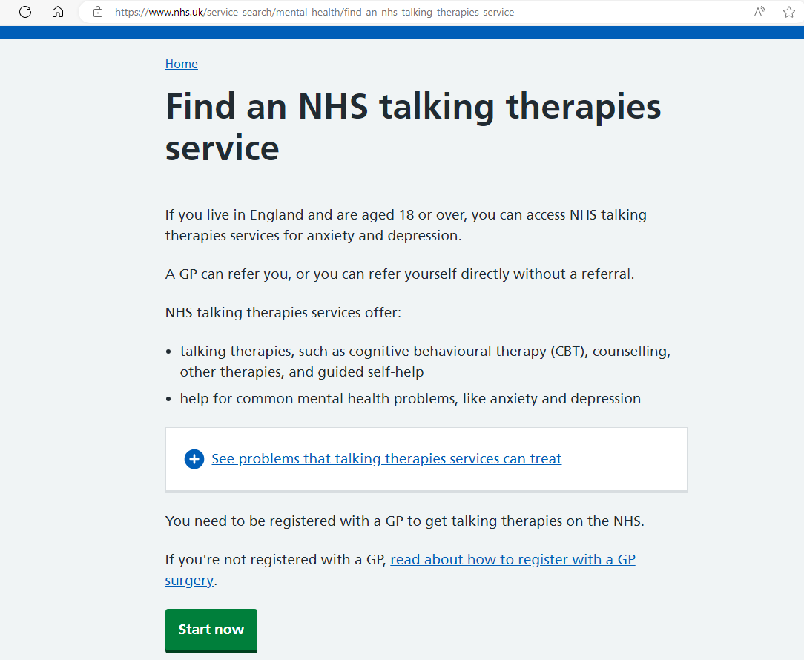

Slide 24
Strategies that can help: Recognising neurodiversity in families
Studying children with autism and their parents, researchers have found that when a child has autism, his or her parents are more likely to have autistic traits than parents who don’t have a child with an autism spectrum disorder
If you think this may be relevant to you, discuss this with your GP
Our EBE said- “It was only after seeing our little one had autism +/- ADHD that his dad and I both wondered about our own neurodiversity. I realised why I found parenting so much harder. The sensory overload from constant touch and constant noise/movement is really difficult and I can get overwhelmed. Now I'm conscious of it”

Slide 25
Conclusion
This is hard, rewarding work
You need to look after yourself as you can’t pour from an empty cup
Support is available, but you may need to be persistent to access it
Connect with Amanati
www.amanati.org
info@amanati.org
Stay in touch
Instagram: @draminaa
Linked in: Dr Amina Al-Yassin

